Slide 1





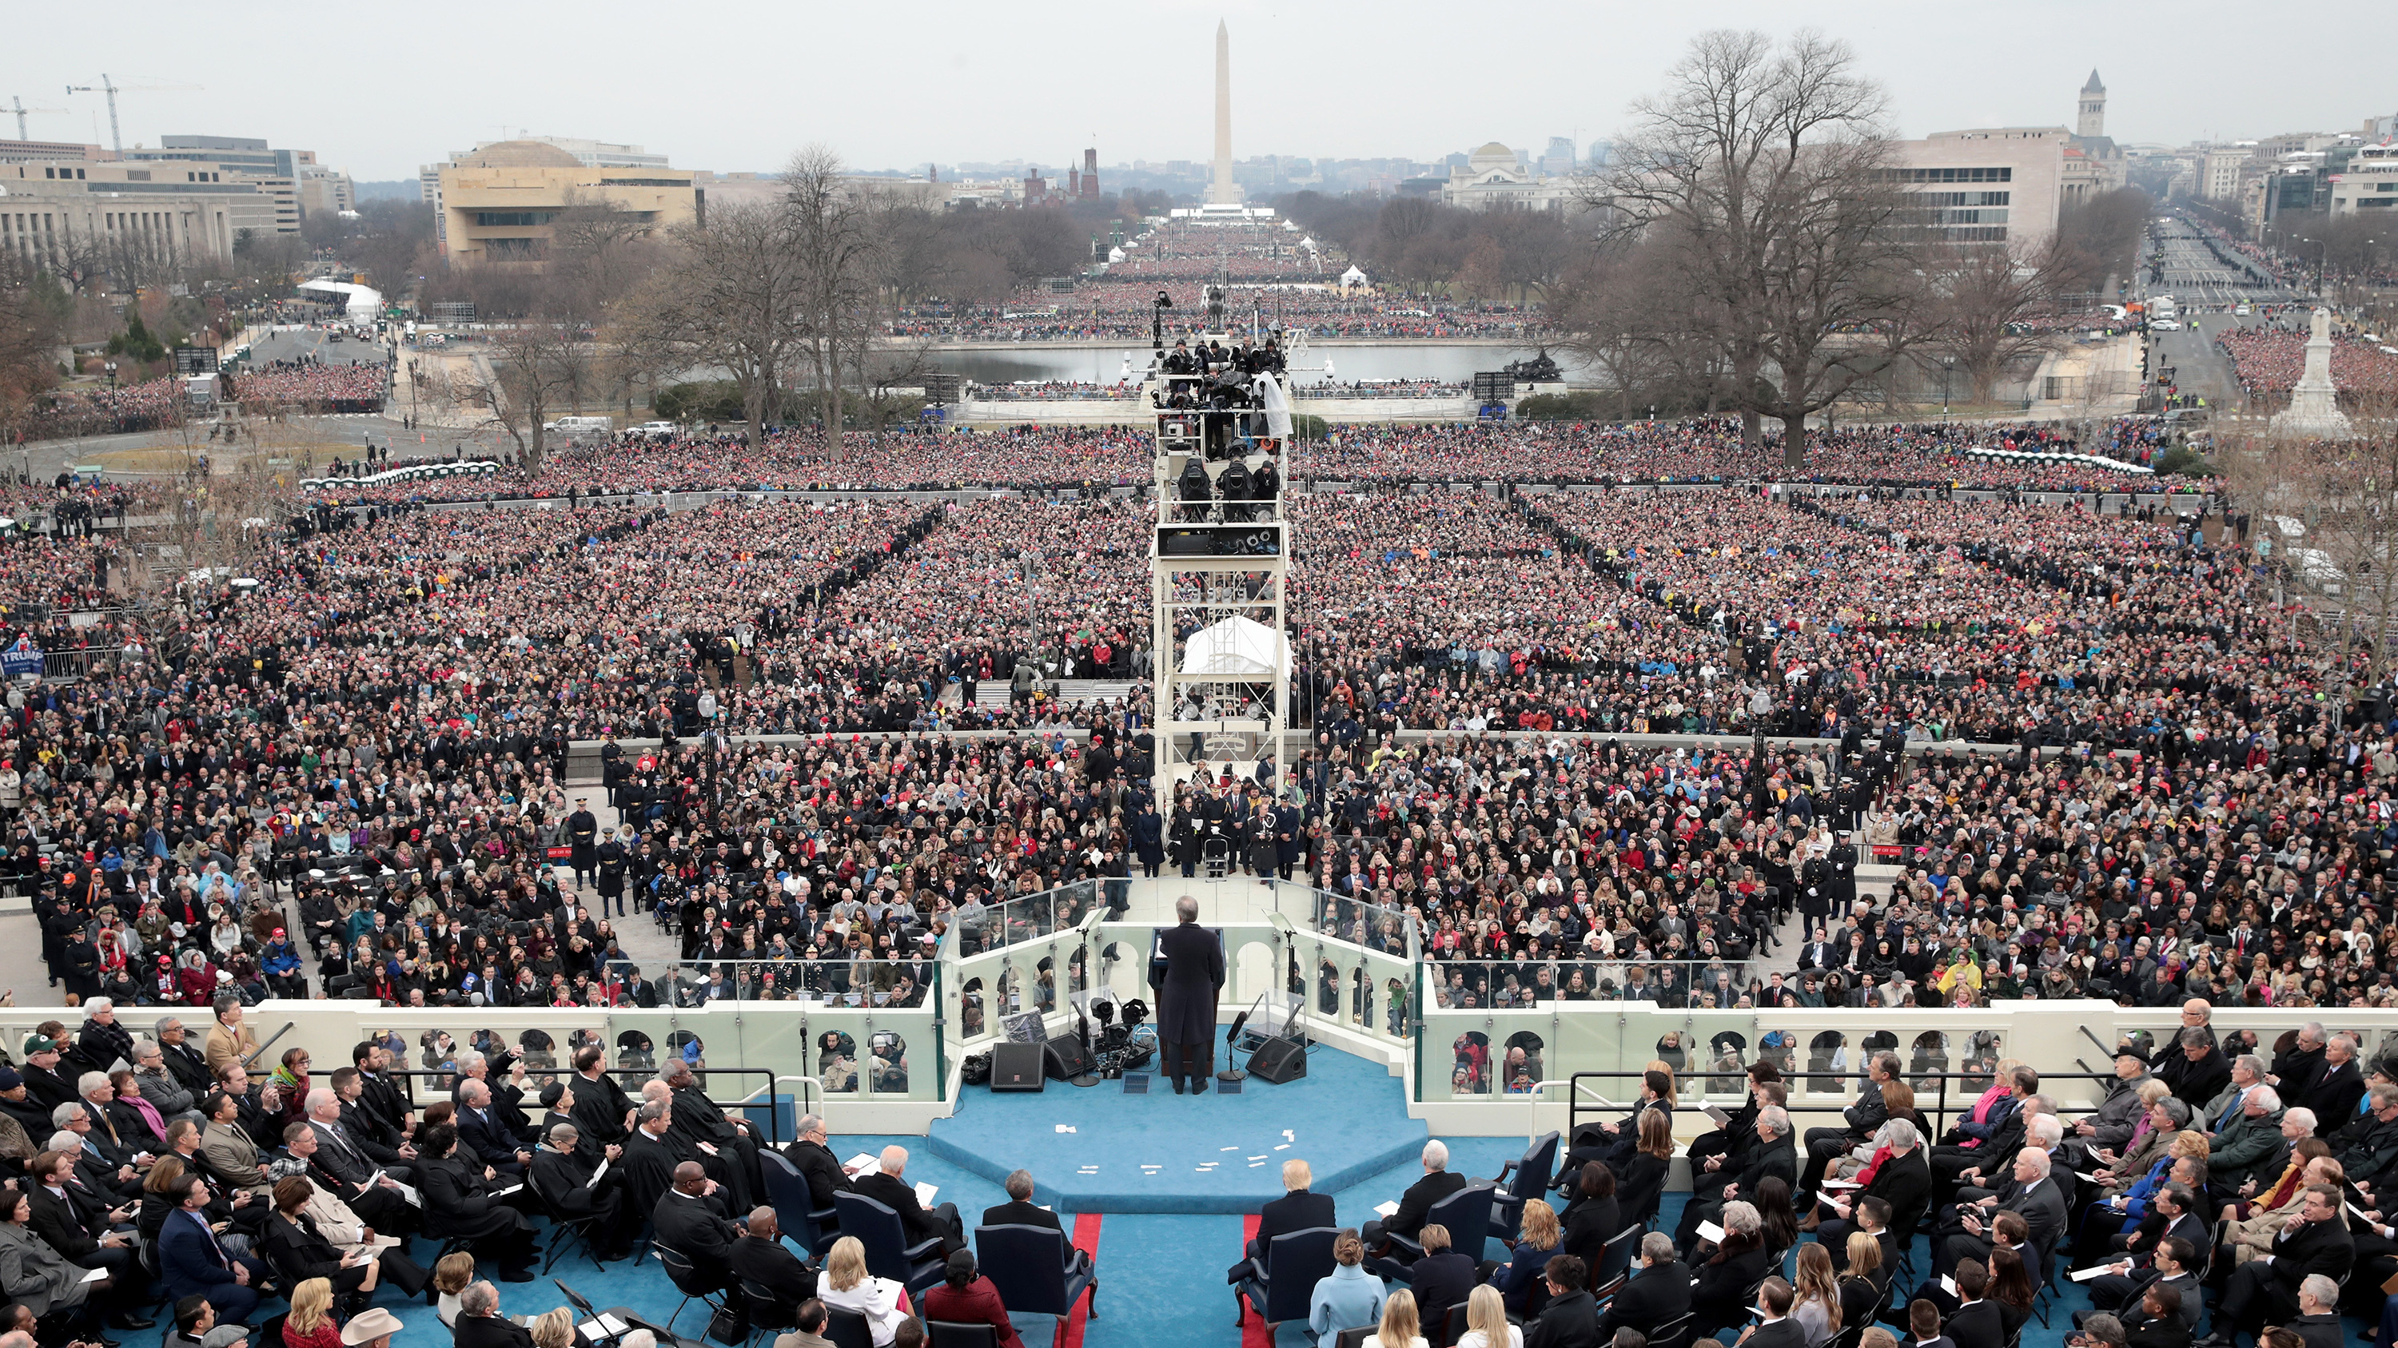
Home About Addresses Methods Results
Inaugural Addresses
Project Overview

Slide 2




Home About Addresses Methods Results
Inaugural Addresses
About Project
Team Overview

Slide 3






Home About Addresses Methods Results
Inaugural Addresses
Metadata
Address Text
Fellow-Citizens of the Senate and of the House of Representatives:
Among the vicissitudes incident to life no event could have filled me with greater anxieties than that of which the notification was transmitted by your order, and received on the 14th day of the present month. On the one hand, I was summoned by my country, whose voice I can never hear but with veneration and love, from a retreat which I had chosen with the fondest predilection, and, in my flattering hopes, with an immutable decision, as the asylum of my declining years—a retreat which was rendered every day more necessary as well
Brief discussion of markup?
Reveal Markup
Theme
Theme

Slide 4
Home About Addresses Methods Results
Inaugural Addresses
List view???
1.
2.
3.
4.
5.
Organizational tools?
*Party
*Religion
*Occupation

Slide 5
Home About Addresses Methods Results
Inaugural Addresses
Address Text
Fellow-Citizens of the Senate and of the House of Representatives:
Among the vicissitudes incident to life no event could have filled me with greater anxieties than that of which the notification was transmitted by your order, and received on the 14th day of the present month. On the one hand, I was summoned by my country, whose voice I can never hear but with veneration and love, from a retreat which I had chosen with the fondest predilection, and, in my flattering hopes, with an immutable decision, as the asylum of my declining years—a retreat which was rendered every day more necessary as well as more dear to me by the addition of habit to inclination, and of frequent interruptions in my health to the gradual waste committed on it by time.
Metadata
Brief discussion of markup?
Reveal Markup
Theme
Theme

Slide 6

Home About Addresses Methods Results
Inaugural Addresses
*Some side bar?
*Jump to?
*Other Resources?
Markup?
Mallet?
XSLT

Slide 7

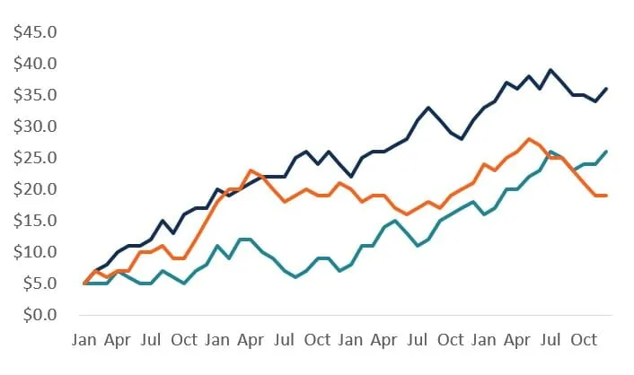
Home About Addresses Methods Results
Inaugural Addresses
Results
*Some side bar?
*Jump to?
*Other Resources?
Conclusions

